Slide 1

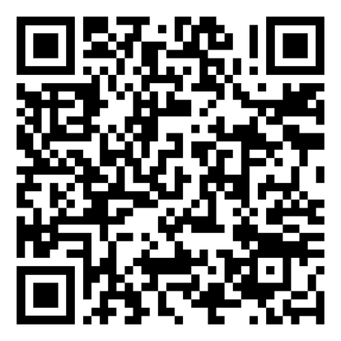

Built for Freedom
Men’s Summit
@ Cohutta Springs
September 13-15, 2024
Register Today
Registration Ends Sep 1
www.BlueprintForMen.org

