Slide 1




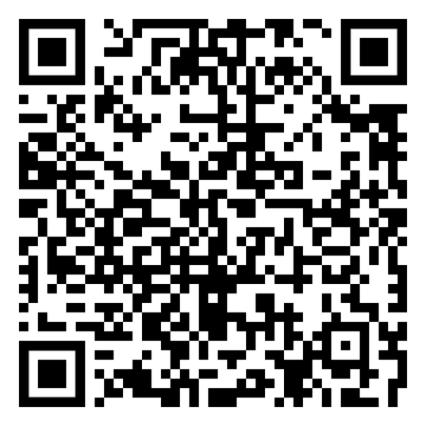

Kentucky-Tennesse Conference
MEN UNDER CONSTRUCTION RETREAT
Location: Indian Creek Camp
October 27-29, 2023
REGISTER HERE
Deadline October 20th
www.blueprintformen.org

