Slide 1




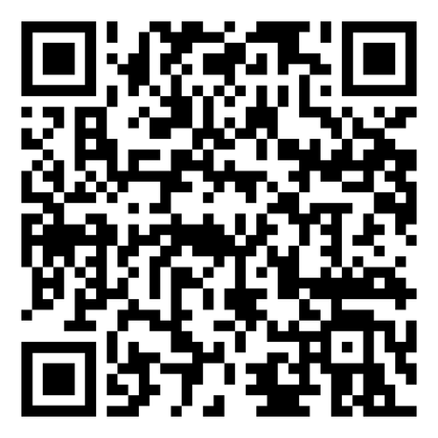

Georgia-Cumberland Conference
MEN UNDER CONSTRUCTION RETREAT
Cohutta Springs Conference Center
October 6-8, 2023
REGISTER HERE
Deadline Sept 27
www.blueprintformen.org

