Slide 1
Vision 2020 A Strategic Plan to Build a Strong Men’s Ministry in the Southern Union of Seventh-day Adventists
By Marty Miller, Blueprint for Men, Founder & President

Slide 2
Presentation Outline
I. Story: The Manhood Journey
II. Problem: Manhood Crisis
III. Solution: Strong Men of God
IV. System: Blueprint for Men
V. Vision: Expanding Horizons
VI. Investing: Ministry Partners

Slide 3
I. Story: The Manhood Journey

Slide 4
Trust in the LORD with all your heart and lean not on your own understanding; in all your ways acknowledge him, and he will direct your paths. Proverbs 3:5-6
The Manhood Journey

Slide 5
What’s Your Manhood Story?
On a scale of 1-5 rate the following statements as they relate to your life as a man…
My father taught me and guided me into manhood.
I had a clear definition of authentic manhood.
I was prepared for marriage and fatherhood.
I have experienced a support and accountability group.
I have been mentored and seek to mentor other men.
I have been successful in overcoming repetitive sin.
I have experienced a consistent walk with God.
I have stewarded my resources responsibly.
I have given my family solid spiritual leadership.
I have made and follow written goals and plans for my life.

Slide 6
This missing link
for most men…

Slide 7
II. Problem: Manhood Crisis

Slide 8
Men are Increasingly Secular

Slide 9
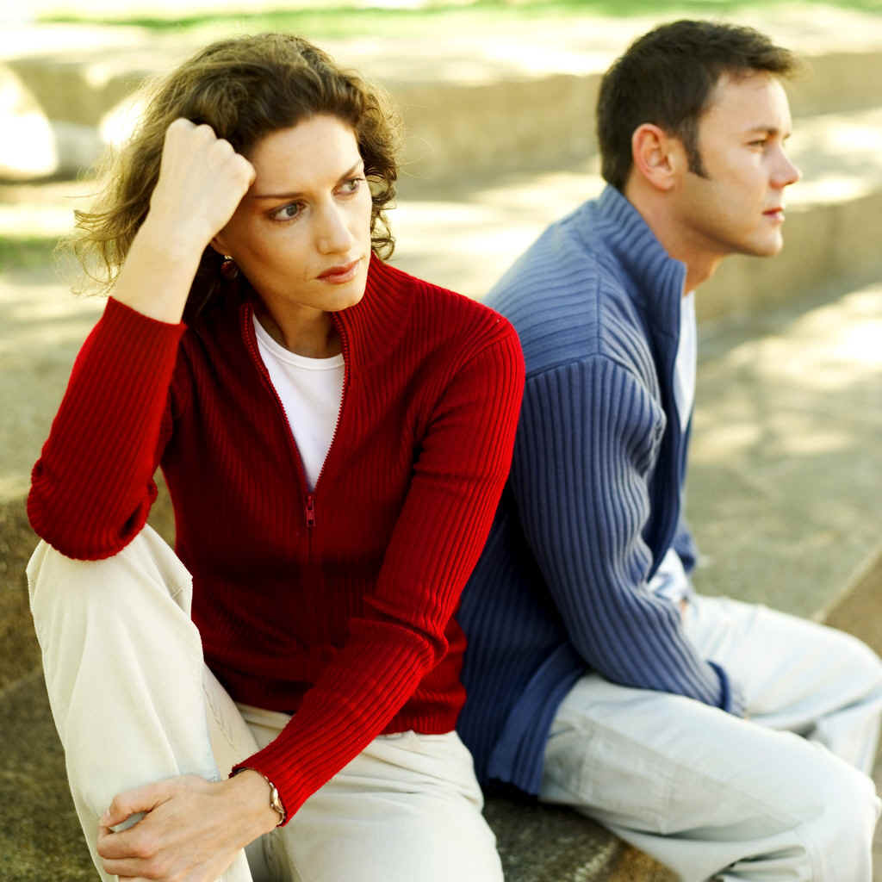
Men are Increasingly Disconnected in Marriage…

Slide 10
Men are increasingly disconnected from their children…

Slide 11
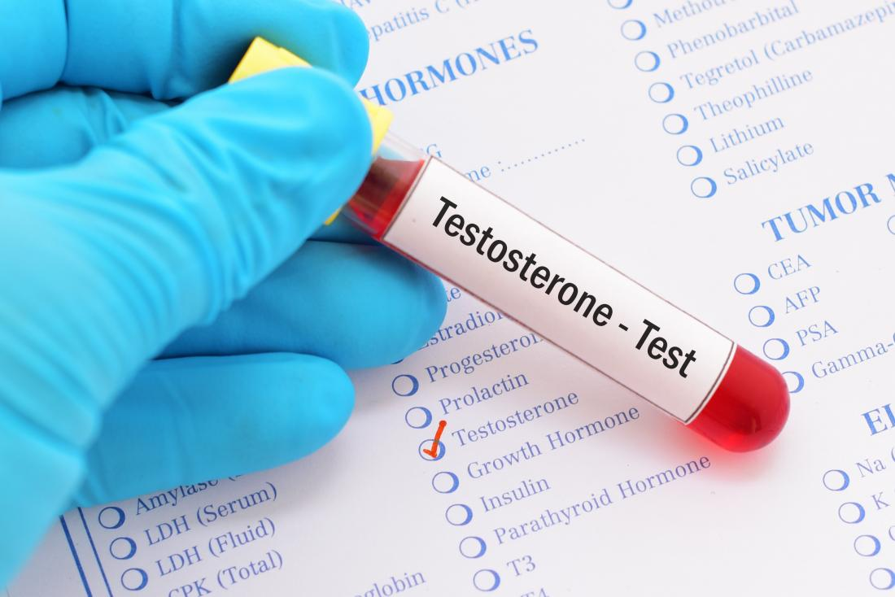
Men Are Less Masculine

Slide 12
Boys Are Struggling More in School

Slide 13
Men Are Increasingly Addicted

Slide 14
Young Men Are Not Maturing

Slide 15
Men are Lacking Manly Skills

Slide 16
Men are Lacking Direction and Purpose

Slide 17
Men are Increasingly Isolated

Slide 18
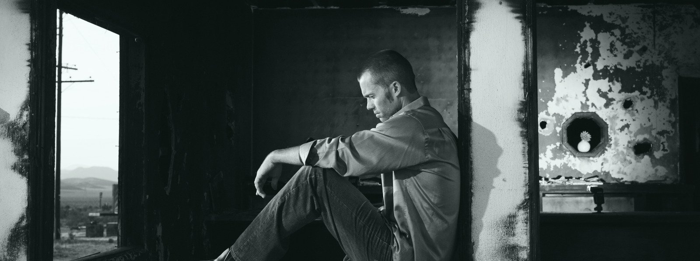
Why are men struggling?

Slide 19
Strong Men of God SEEK OUT
Knowledge & Discipline
A Walk with God
Guidance & Leadership
Wise Plans & SMART Goals
Brotherhood & Accountability

Slide 20
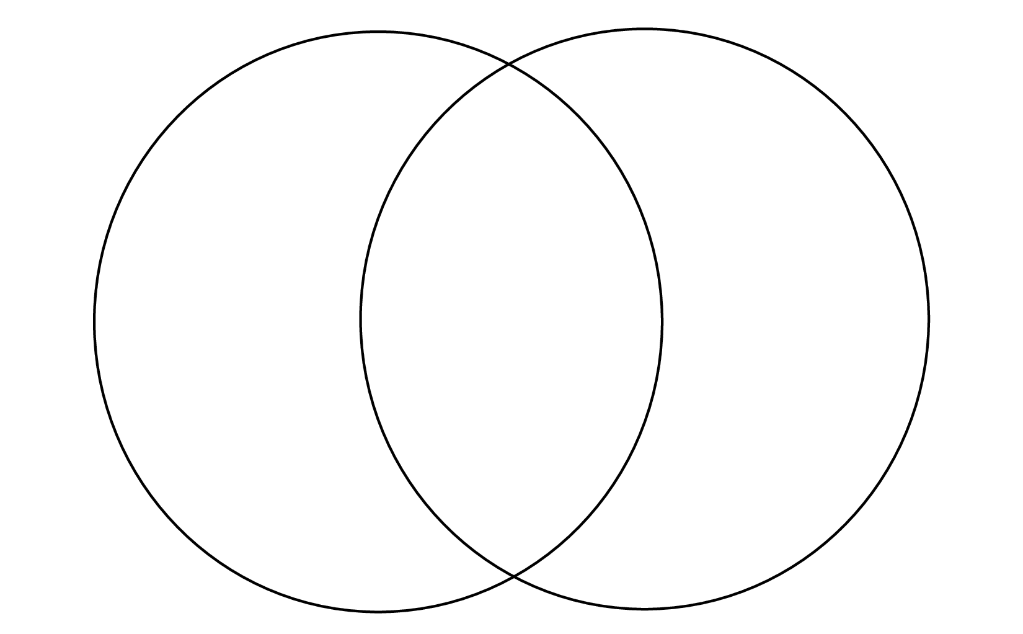
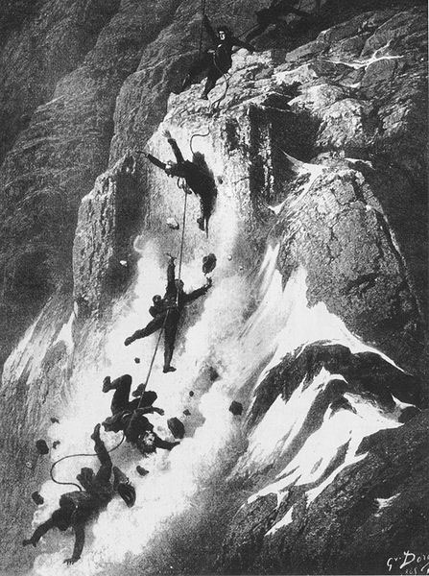
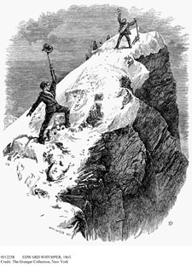
Outdoor Risk Management
Accident
Potential
Subjective
Danger
Objective
Danger

Slide 21
Manhood Risk Management
Accident
Potential
Subjective
Danger
Objective
Danger

Slide 22
REDUCING MEN’S “Accident Potential” through…
A Walk with God
Knowledge & Discipline
Guidance & Leadership
Wise Plans & SMART Goals
Brotherhood & Accountability

Slide 23
III. Solution: Strong Men of God

Slide 24
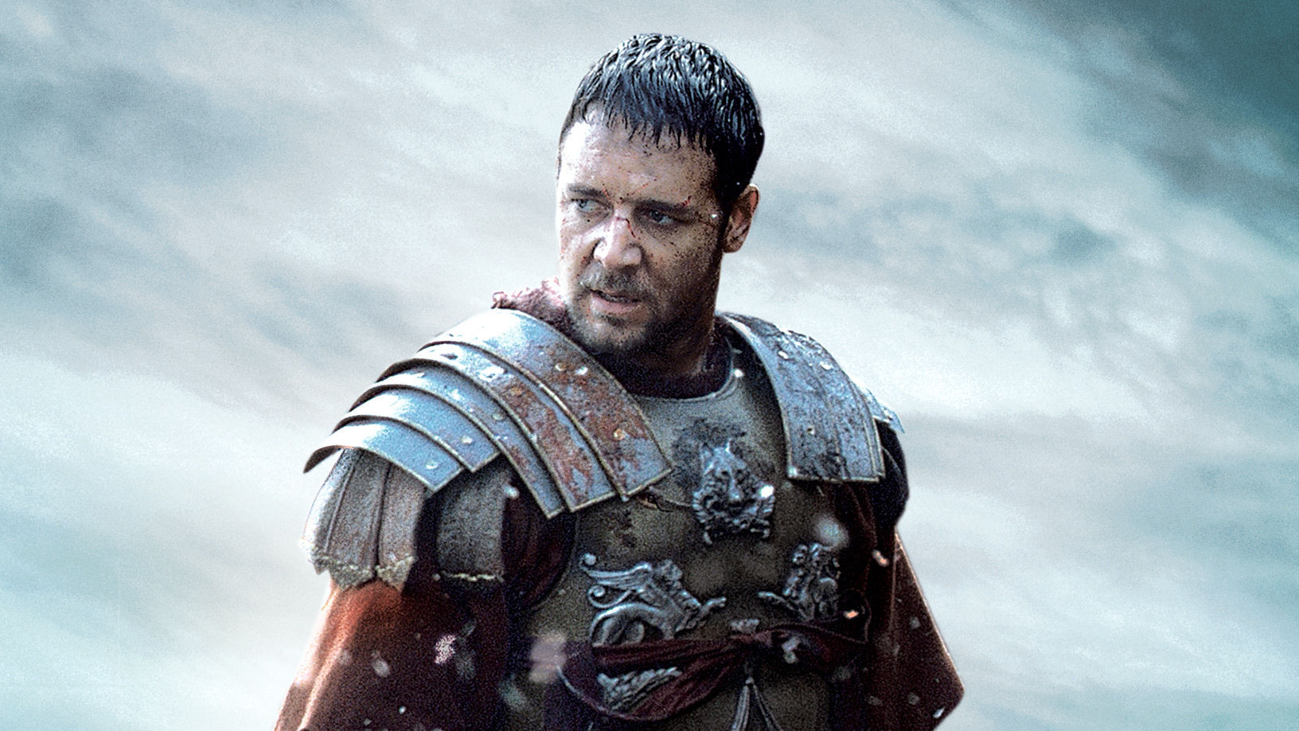
Strong Men of God
Watch, stand fast in the faith, be brave, be strong. ~I Corinthians 16:13

Slide 25
Character Traits of Strong Men of God
Reject
Reject Passivity
Accept
Accept Responsibility
Lead
Lead Courageously
Love
Love Unconditionally
Live
Live with Integrity
Serve
Serve Humbly
Invest
Invest Eternally

Slide 26
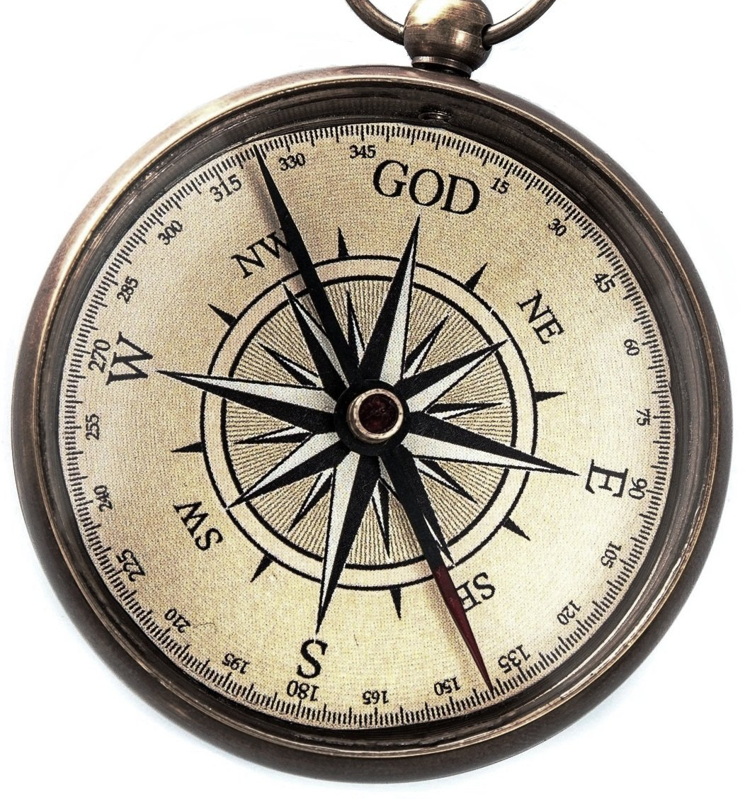
WANTED: Men of Integrity
“The greatest want of the world is the want of men-- men who will not be bought or sold, men who in their inmost souls are true and honest, men who do not fear to call sin by its right name, men whose conscience is as true to duty as the needle to the pole, men who will stand for the right though the heavens fall.” Education, p. 57

Slide 27
Wanted: Men of Integrity
The righteous man walks with integrity; blessed are his children after him.
Proverbs 20:7

Slide 28
WANTED: Strong Family Leaders
The greatest evidence of the power of Christianity that can be presented to the world is a well-ordered, well-disciplined family. This will recommend the truth as nothing else can, for it is a living witness of its practical power upon the heart. Adventist Home, p. 32

Slide 29
Wanted: Strong Family Leaders
Fathers, do not exasperate your children; instead, bring them up in the training and instruction of the Lord.
Ephesians 6:1-4

Slide 30
the MOST IMPORTANT MINISTRY in the church because it builds…
STRONG MEN OF GOD that are essential for building
STRONG FAMILIES that build
STRONG CHURCHES!
MEN’S MINISTRY

Slide 31
IV. System: Blueprint for Men

Slide 32
Standing in the Gap
I looked for someone among them who would build up the wall and stand before me in the gap on behalf of the land so I would not have to destroy it, but I found no one.
Ezekiel 22:30

Slide 33
Blueprint for Men Standing in the gap for the church since 2014
A Christ-centered, relationship-based men’s ministry that helps men succeed and lead in every area of life.

Slide 34
Ministry Funnel
INPUT
Men Who Are Struggling Alone
Website & Social
Strategic Events
Small Groups
Leadership Development
Drifting - Come and See
Casual - Follow Me
Invested - Abide with Me
Committed - Fruitful in Me
OUTPUT
Strong Men of God

Slide 35
Blueprint for Men Provides
1.
Strategic Events
2.
Small Group Support
3.
Leadership Training
4.
Resources & Curriculum
5.
Men’s Ministry Consulting

Slide 36
1. BLUEPRINT FOR MEN EVENTS
Father-Son/Daughter Retreats
Men’s Prayer Breakfasts
Outdoor Recreation & Adventure
Conventions, Retreats, Rallies
Seminars & Training

Slide 37
Blueprint Strategic Events (Measured in Contact Man Hours)

Slide 38
Strategic Event Testimony…
“I left The Blessing Father-Son Retreat with wisdom from the presentations, and encouragement from other fathers who are trying to raise boys who are ready for the challenges of manhood.
~ Father-Son Retreat Participant

Slide 39
2. BLUEPRINT FOR MEN GROUPS
A. Manhood
B. Discipleship
C. Recovery

Slide 40
Blueprint Network of Small Groups

Slide 41
A. Manhood Practical Living Strategies that Help Men Succeed and Lead in Every Stage of Life through… Training Certification Mentoring (Development Phase)
STAGES IN A MAN’S LIFE JOURNEY
Cornerstone (12-24) Characterized by Identity
Bondstone (25-44) Characterized by Strength
Keystone (45-64) Characterized by Influence
Capstone (65+) Characterized by Wisdom
RESPONSIBILITIES IN A MAN’S LIFE JOURNEY
Marriage Preparation & Enrichment
Fatherhood Preparation & Coaching

Slide 42
Manhood Education Testimony
I want to praise the Lord for this ministry and what it has done for my husband. Thank you!
~ Wife of a Transformed Man

Slide 43
B. Discipleship Spiritual Development for Every Man
Walking with God
Bible Study & Memorization
Journaling, Meditation & Prayer
Overcoming Repetitive Sin
Discipleship Curriculum

Slide 44
Men’s Discipleship Strategy
Disciple 3 Men/Year

Slide 45
Discipleship Group Testimony
Being a part of a men’s discipleship group has been a life-changing experience! My relationship with God has grown deeper and my spiritual leadership at home has become stronger.
~ Discipleship Group Participant

Slide 46
C. Recovery Overcoming addiction through bible based recovery strategies.
Group Confidentiality
Weekly Meetings
Daily Online Accountability
Authenticity & Honesty
Trained Experienced Leaders
Bible-Based Recovery Curriculum

Slide 47
Recovery Group Testimony…
My pornography addiction was destroying my life and marriage. There didn’t seem to be any way I could break free… until I joined a Men of Integrity recovery and support group. Now, through the encouragement of other men and a growing relationship with Christ I am “more than a conqueror”… praise God!
~ Men of Integrity Group Participant

Slide 48
3. BLUEPRINT FOR MEN LEADERSHIP (Development Phase)
DISTANCE LEARNING
Webinar Series
Video Conferencing
Coaching Calls
ON LOCATION
Weekend Intensive
12-Week Series

Slide 49
4. BLUEPRINT FOR MEN RESOURCES
EXAMPLES INCLUDE…
RightNow Media
ReThink Disciple-Making
Resolute Books & Videos
Real Men Connect Podcast
Every Man a Warrior
Men’s Fraternity

Slide 50
5. BLUEPRINT FOR MEN CONSULTING
Consulting Program Includes:
Church Level Ministry Start-up Program
Extended Leadership Coaching
Conference Level Strategy Development

Slide 51
V. Vision: Expanding Horizons

Slide 52
The Southern Union Men’s Leadership Summit Cohutta Springs Conference Center April 24-26, 2019
Men’s ministry leaders who proposed VISION 2020.

Slide 53
Southern Union Conference of Seventh-day Adventists
8 Conferences
300,000 Members
1095 Churches
186 Elementary Schools
16 Academies
3 universities and colleges
13 Healthcare Facilities

Slide 54
Southern Union Men’s Ministry Challenges
Vision No long-range plan
Ministry Seen as a low priority
Focus Mostly limited to large events
Funding Severely underfunded < 0.1% of budget
Leaders Unsupported and untrained
Resources Very limited through our denomination
Networking Disconnected and isolated
Event No Southern Union Convention

Slide 55
Southern Union Men’s Ministry Solutions
Vision VISION 2020 – A 10-year Plan
Ministry Men’s ministry is a high priority
Focus Wide spectrum of opportunities
Funding Increase to 1% of church budget
Leaders Empowered, trained, and networked
Resources Continual adoption and development
Networking Regular communication and engagement
Event Southern Union Convention 2021

Slide 56
Vision 2020: Building a Strong Men’s Ministry in the Southern Union
Our Identity
Identifying Men
Reaching Men
(re)Building Men
Building Leaders
Building Community
Building a Movement

Slide 57
VISION 2020 1 OUR IDENTITY
SOUTHERN UNION MEN’S MINISTRY
ADVENT MEN
A Christ-centered, relationship-based, network of Southern Union men’s ministries that have a shared vision and strategy for building strong men of God.

Slide 58
VISION 2020 2. IDENTIFYING OUR MEN
Men are Identified by their…
Stage of Life
Roles and Responsibilities
Social Status
Spiritual Development
Interests and Hobbies
Life Crisis
Database development is essential

Slide 59
VISION 2020 3. REACHING OUR MEN
Men Are Reached Through…
“My Blueprint” an Online Assessment
Social media, website, email, texts
Publications and bulletin announcements
Personal Contact… the best method

Slide 60
VISION 2020 4. (RE)BUILDING OUR MEN
The “Blueprint System” builds men through…
Manhood Education
Discipleship and Mentoring
Addiction Recovery

Slide 61
VISION 2020 5. BUILDING LEADERS
Men’s Ministry Leaders are built through…
Men’s Leadership Training & Certification
Seasoned Leaders Mentoring New Leaders
Regular Coaching and Evaluation

Slide 62
VISION 2020 6. BUILDING COMMUNITY
Community is built at every level through…
Shared Vision and Identity
Strategic Events that Gather Men Together
Shared Communications and Message

Slide 63
VISION 2020 7. BUILDING A MOVEMENT
VISION 2020 is a strategic 10-year plan designed to build a movement of godly men within the Seventh-day Adventist Church.

Slide 64
Vision 2020: Building a Movement of Men
2020.0 Phase I Building Conference Leaders
2020.5 Phase II Building Church Leaders
2021.0 Phase III Building Small Groups
2021.5 Phase IV Launching a Movement
2022 Phase V Accelerating Momentum
2021
Southern Union Convention
2025 Phase VI Expanding the Movement
Phase VII Celebrating the Movement
2029
NAD Men’s Congress

Slide 65
VI. Investing: Ministry Partners

Slide 66
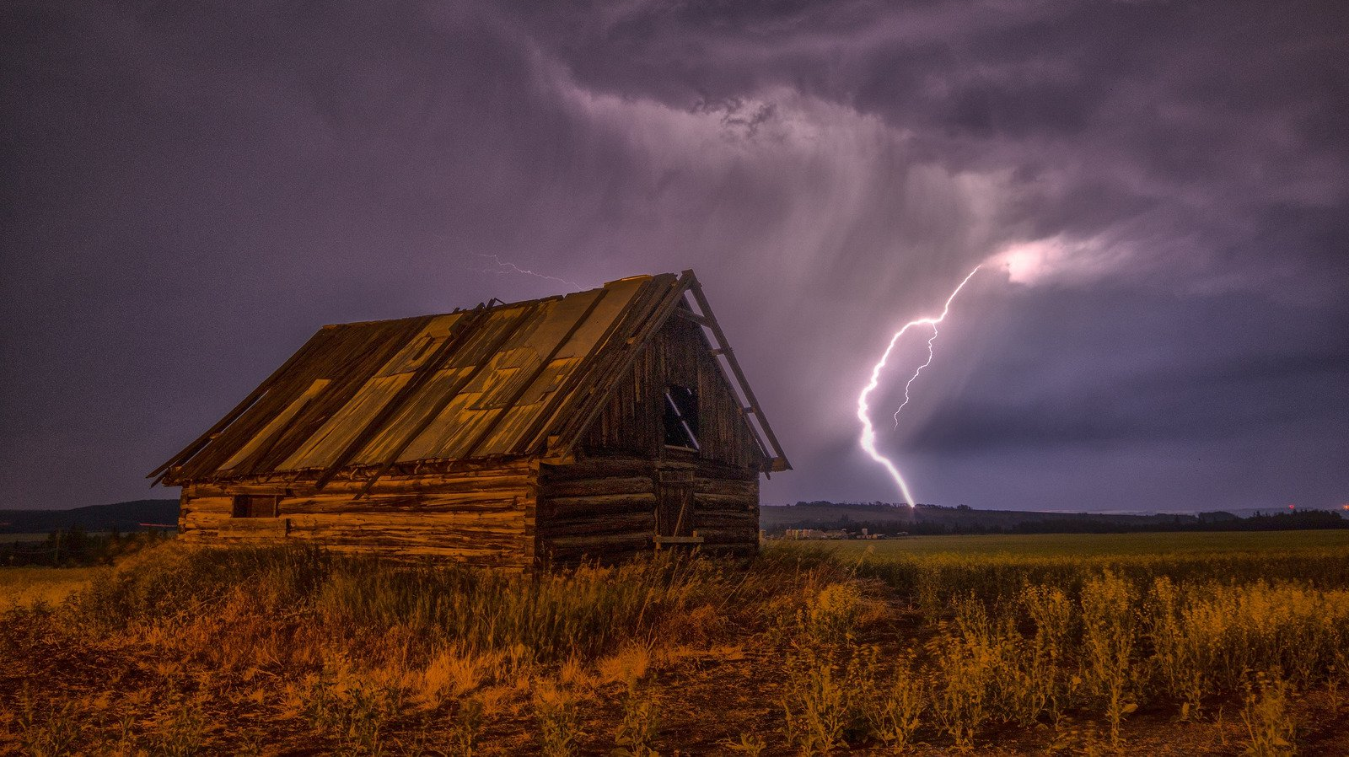
Powerful Partnership
When ground level energy and upper level charge unite…
THERE IS POWER!

Slide 67
MAXIMUM
ROI
Return on Investment
WHY INVEST IN MEN’S MINISTRY?

Slide 68
CURRENT CHURCH MEN’S MINISTRY FINANCIAL INVESTMENT
< 0.1% of Budget
< $5.00 per man

Slide 69
Men’s Ministry has the greatest potential to deliver the greatest Return on Investment of any ministry in the church.

Slide 70
It’s time to build Strong Men of God…

Slide 71
that build Strong Families…

Slide 72
that build a Strong Church.

Slide 73
Let’s build a Strong Men’s Ministry and get the job done!

Slide 74
VISION 2020 Building Strong Men of God in the Southern Union

Slide 75
Next Steps
PRAY
Prayerfully Consider VISION 2020
COMMIT
Vote to Commit to VISION 2020
EMPOWER
Identify and Empower Leadership Team
INVEST
Invest Resources to Accomplish Goals
ENGAGE
Follow Plan and Make Adjustments

Slide 76
Marty Miller
Founder & President
423-322-8491
marty@blueprintformen.org
www.blueprintformen.org

